Slide 1
Truesdale Lake: A Plan for the Future
By Christian Jenne

Slide 2
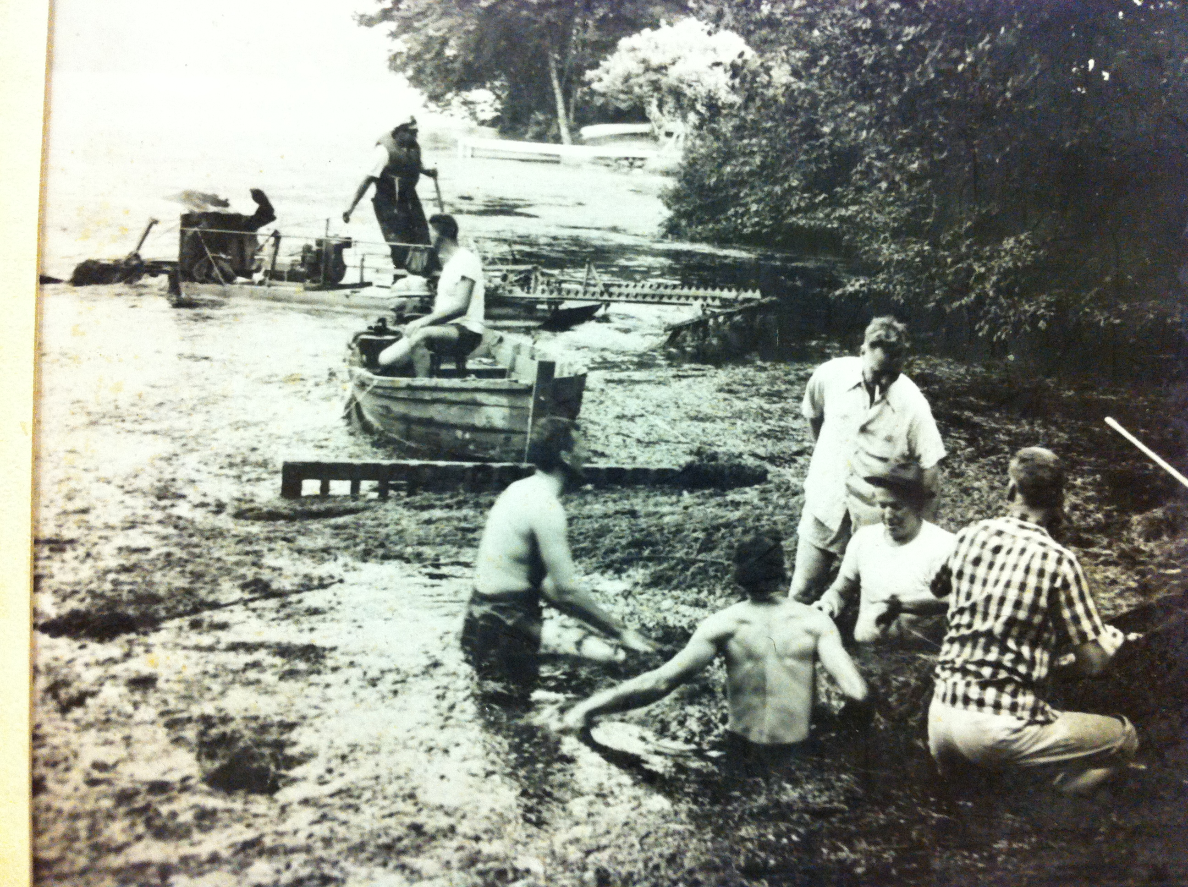
Overview
Lake Description
Past Data
SUNY Oneonta/Solitude© 2014-2015 Data
What's the data showing?
Past Management
Future Management
Early years of hand harvesting. Photo Curtesy of Barbara Cohen

Slide 3
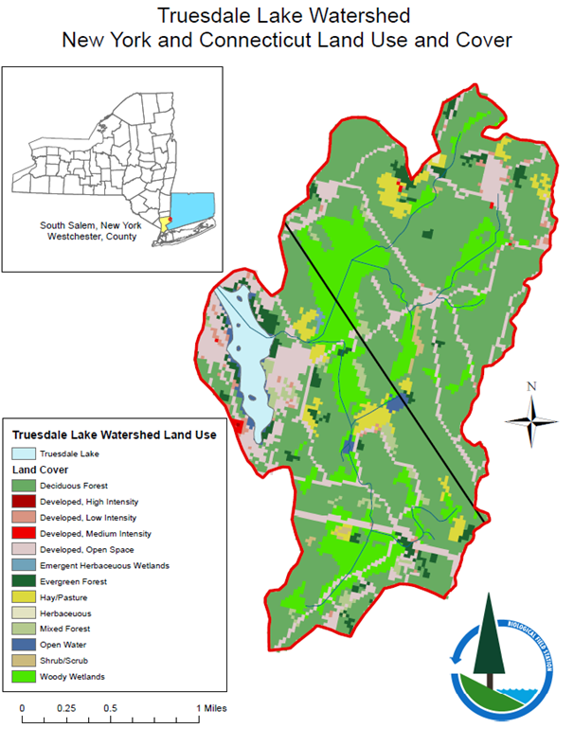
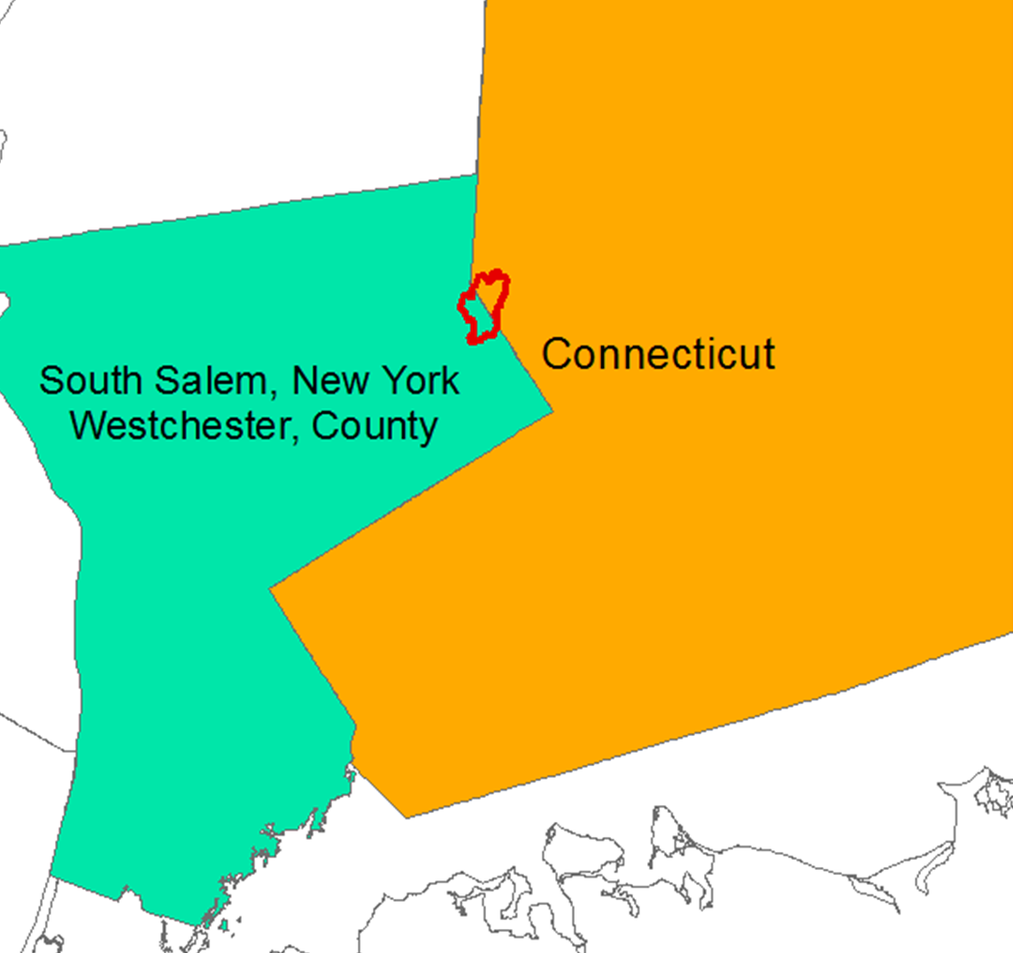
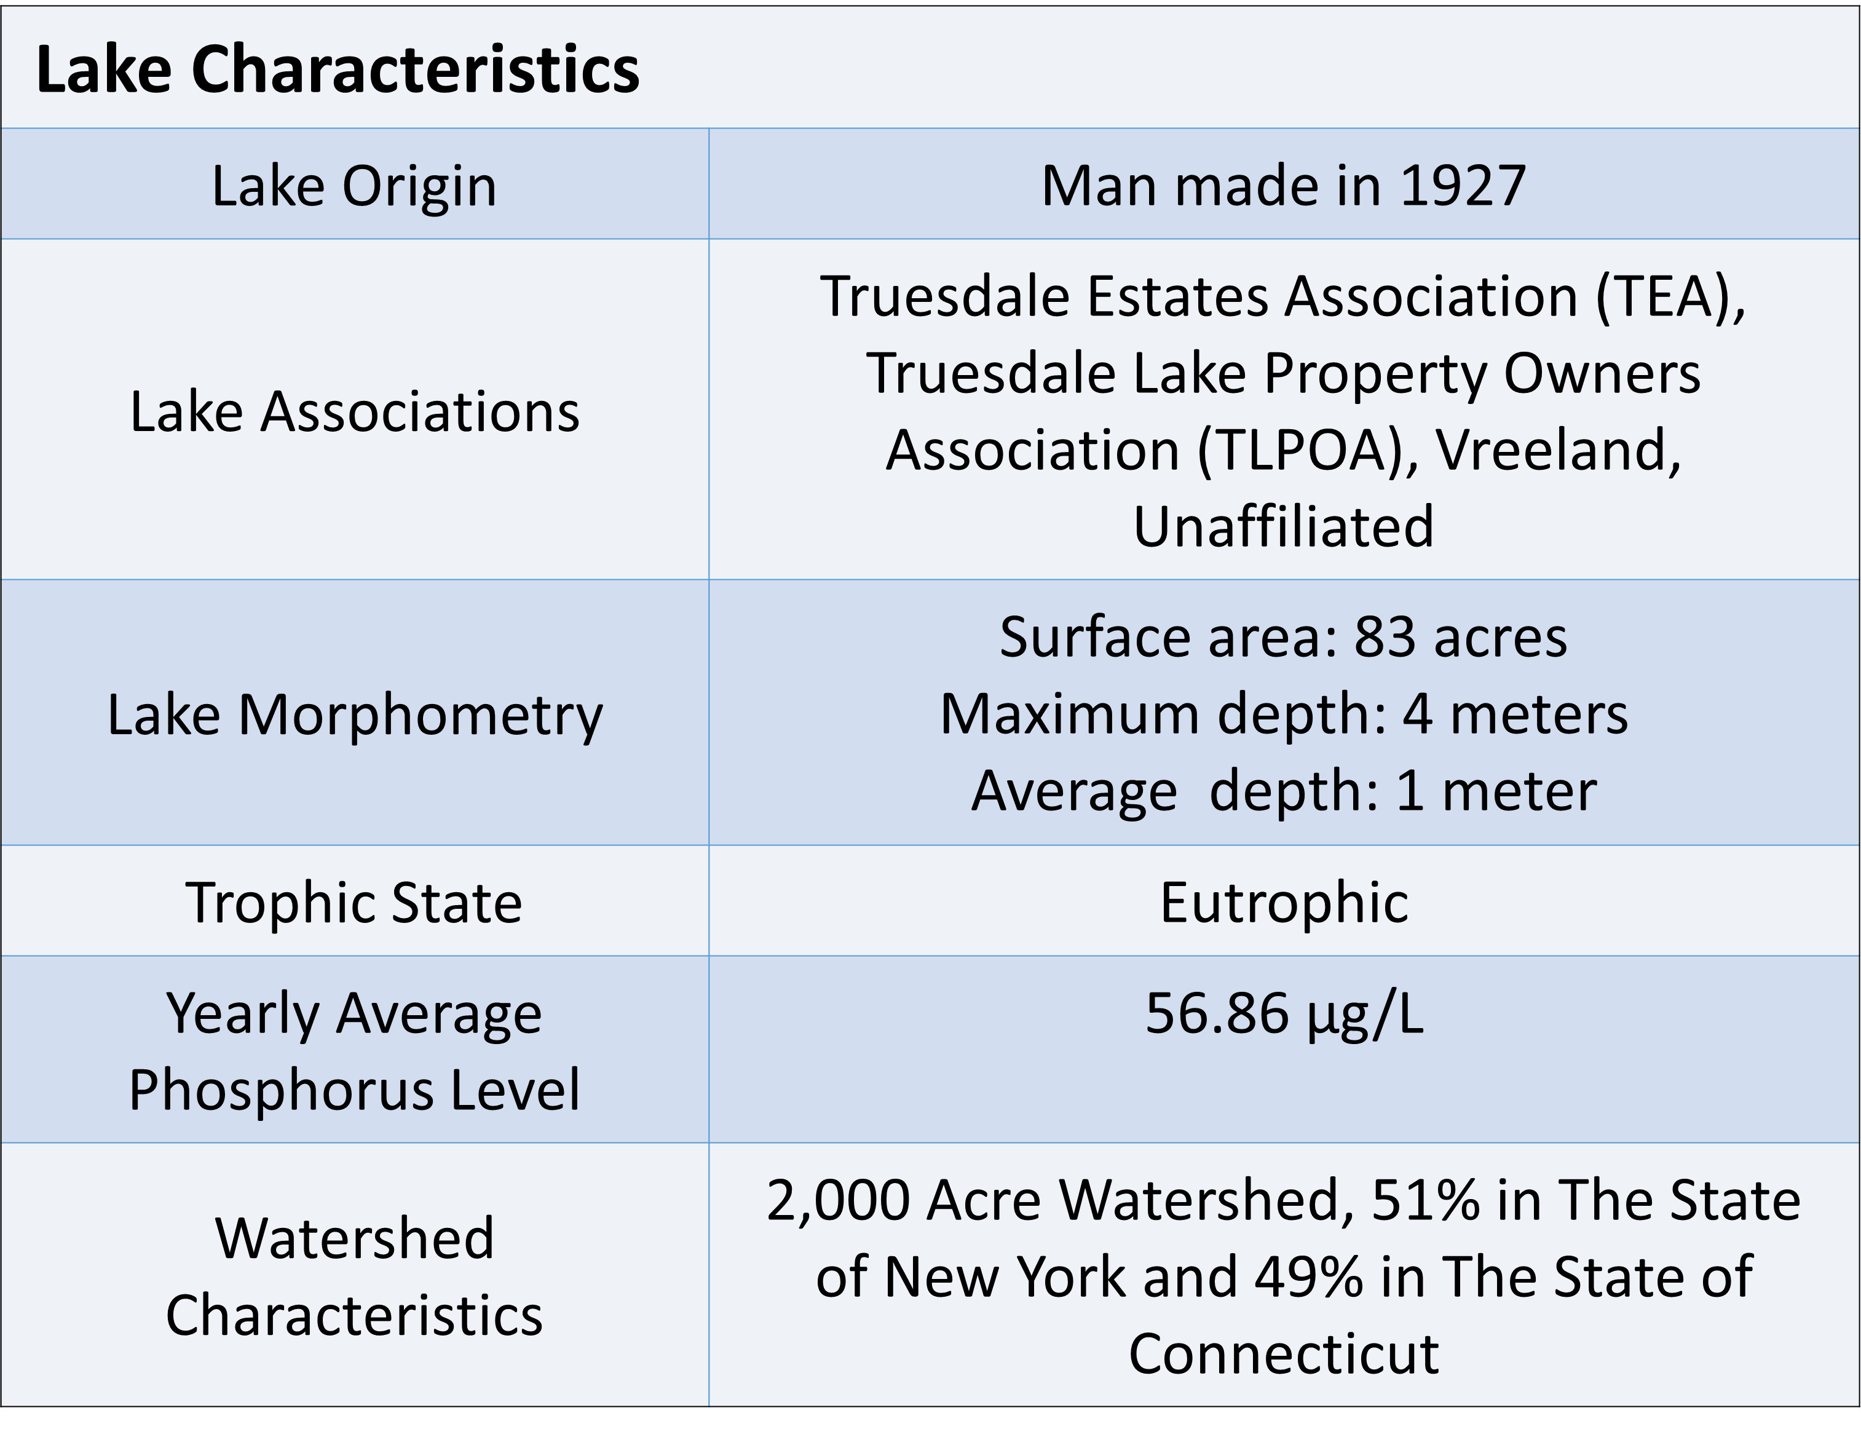
Truesdale Lake
CONN
NY

Slide 4
Oligotrophic Lake
Lower levels of nutrients <10 μg/L of phosphorus
Low biological productivity <2 μg/L of Cholorophyll a
High water clarity >5 meter Secchi Disk Depth
Mesotrophic Lake
Moderate level of nutrients 10-20 μg/L of phosphorus
Moderately productive 2-8 μg/L of Cholorphyll a
Moderate levels of water clarity 2-5 meter Secchi Disk Depth
Eutrophic Lake
Higher level of nutrients >20 μg/L of phosphorus
56 μg/L of phosphorus
High levels of biological productivity >8 μg/L of Chlorophyll a
41.81 μg/L of Chlorophyll a
Low water clarity 2 m Secchi Disk Depth
1 m Secchi Disk Depth

Slide 5
SUNY Oneonta and CSLAP Data
Eutrophic Lake
Higher level of nutrients >20 μg/L of phosphorus
56 μg/L of phosphorus
High levels of biological productivity >8 μg/L of Chlorophyll a
41.81 μg/L of Chlorophyll a
Low water clarity 2 m Secchi Disk Depth
1 m Secchi Disk Depth
Notes:
2009 to 2013 cslap data………… 2015 suny oneonta

Slide 6
SUNY Oneonta and CSLAP Data
Notes:
Annual Summer (May through September) Secchi Transparency, black bars CSLAP 1999-2013, Gray bar SUNY Oneonta data. Dotted line represents NYSDEC trophic state standard.

Slide 7
SUNY Oneonta and Solitude Data
Notes:
Secchi transparency on each date measured summer 2015. Black bars represent Solitude Lake Management data, gray bars represent SUNY Oneonta data.

Slide 8
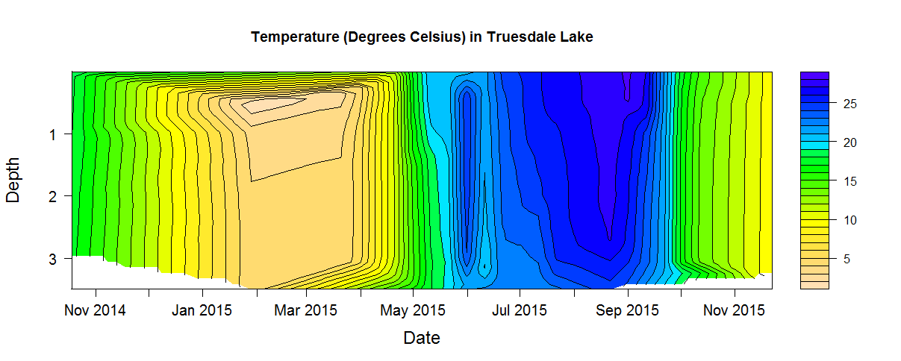
Isopleths 2014-2015
How do we read Isopleths

Slide 9
What are the data saying?

Slide 10
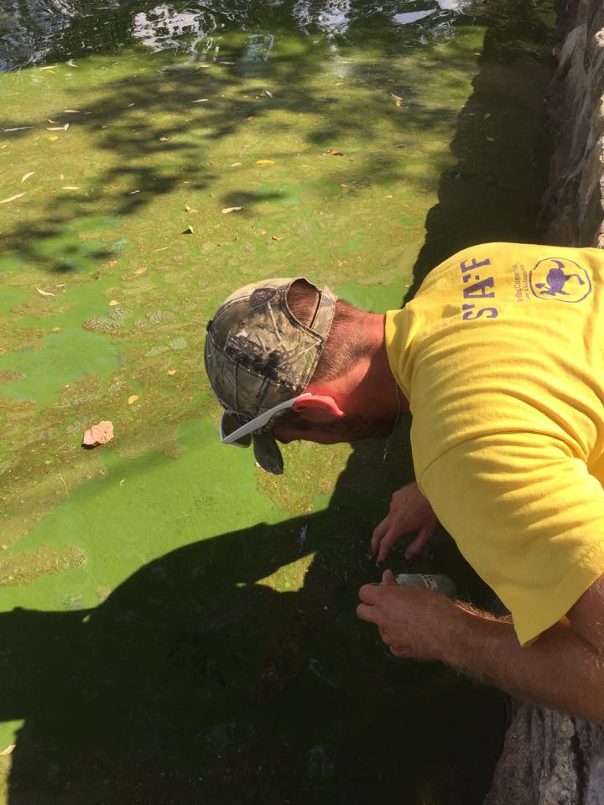
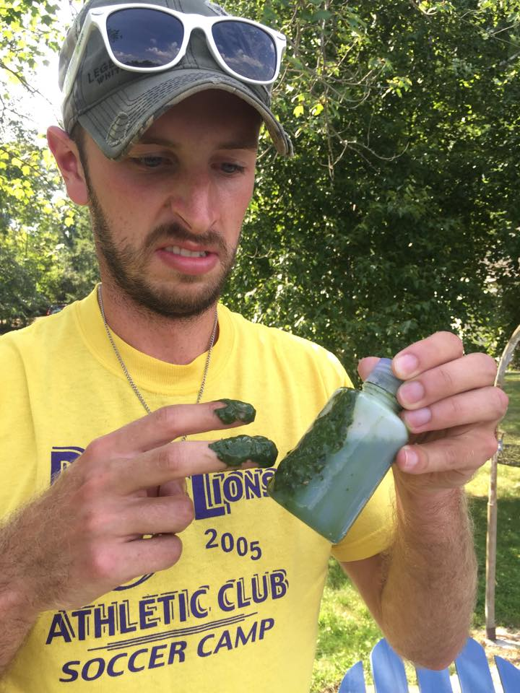
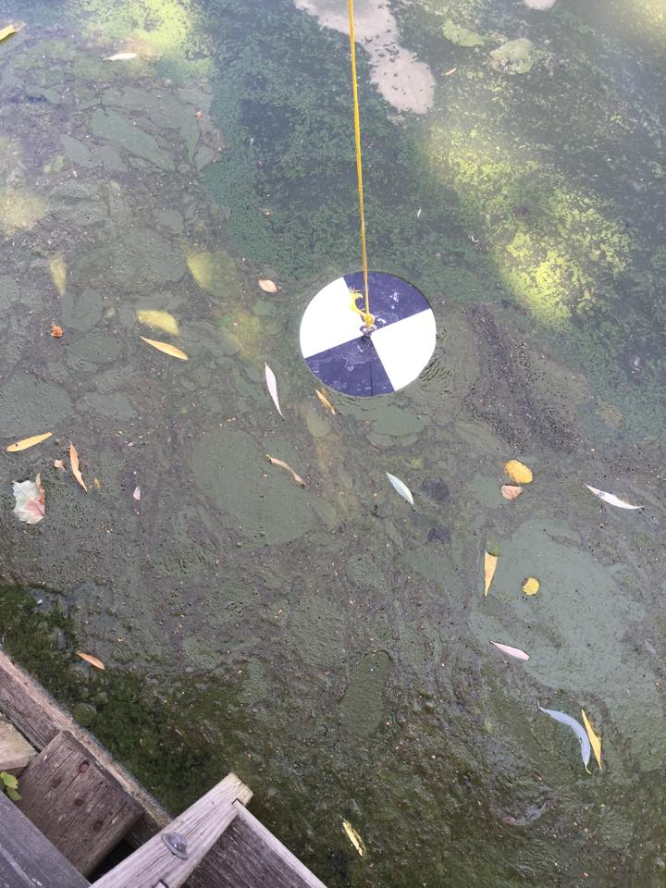
Temperature ºC
Dissolved Oxygen mg/L
Total Phosphorus µg/L

Slide 11
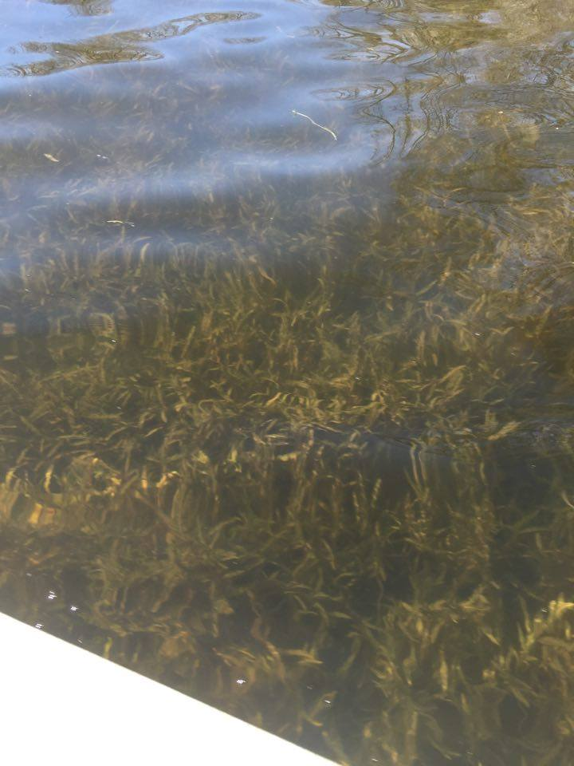
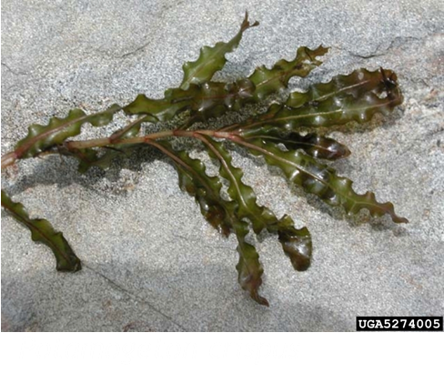
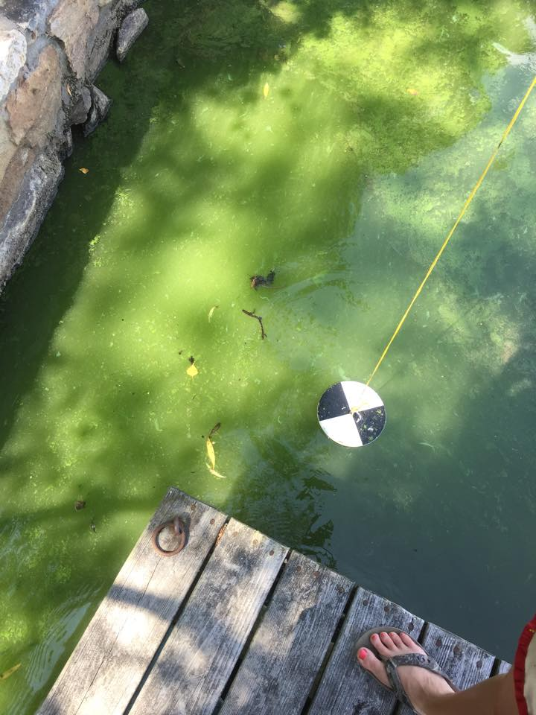
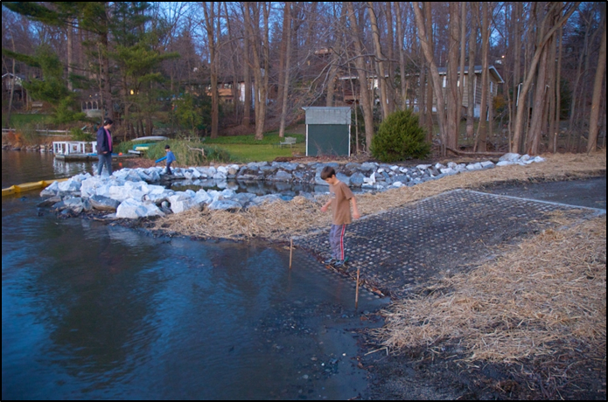
Past Management Techniques
Herbicides
Algaecides
Land-Tech Report 2001

Slide 12
Solitude Lake Management Treatments
2006: 1 Aquathol K¹ Treatment
4 Cooper Sulfate² Treatments
2007: 1 Aquathol K¹ Treatment
5 Cutrine Ultra³ Treatments
2008: 2 Sonar AS⁴ Treatments
5 Copper Sulfate² Treatments
2009: 1 Sonar AS⁴ Treatment 6 Copper Sulfate² Treatments
2010: 1 Aquathol K¹ Treatment 7 Copper Sulfate² Treatments
2011: 1 Aquathol K¹ Treatment 6 Copper Sulfate² Treatments
2013: 1 Sonar AS⁴ Treatment 6 Copper Sulfate² Treatments
2014: 1 Sonar AS⁴ Treatment
4 Copper Sulfate² Treatments 3 GreenCleanPro⁵ Treatments
2012: 1 Sonar AS⁴ Treatment 7 Copper Sulfate² Treatments
2015: 1 Aquathol K¹ Treatment 4 Copper Sulfate² Treatments
Treatment dates supplied by Solitude Lake Management 1. Herbicide 2. Algaecide 3. Algaecide 4. Herbicide 5. Algaecide

Slide 13
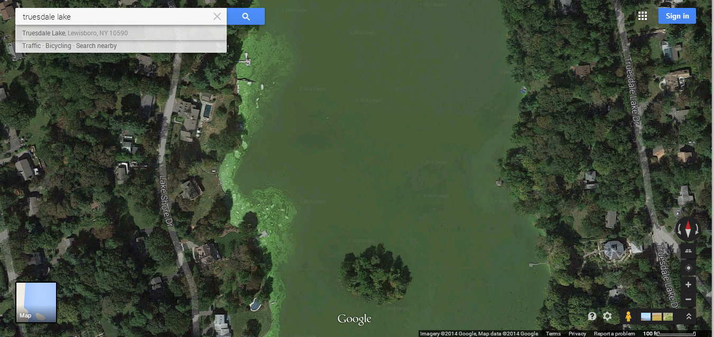
Future Management
Watershed Management
In Home Management
Landscaping Best Management Practices (BMPs)
Maintain and Improve Septic Systems
Stream Bank Enhancement and Sediment Traps (Ryder, 2001)
In-Lake Management
Nuisance Aquatic Vegetation
Mechanical Harvesting
Drawdown
Herbicides
Hand Harvesting
Algae Control
Algaecides
Circulation System
Nutrient Inactivation
Nutrient Uptake
Bacteria Supplement
Floating Wetlands
Summer 2014 Algae Bloom. Photo from Google Earth

Slide 14
Alum Treatment
In Lake Nutrient Inactivation
Inactivates Phosphorus in water
Locks Phosphorus in sediment potentially 10 to 20 years (Diet for a Small Lake)
Does not kill algae or plants
Permitting as a Test Site for the state
Currently not allowed in the State of New York

Slide 15
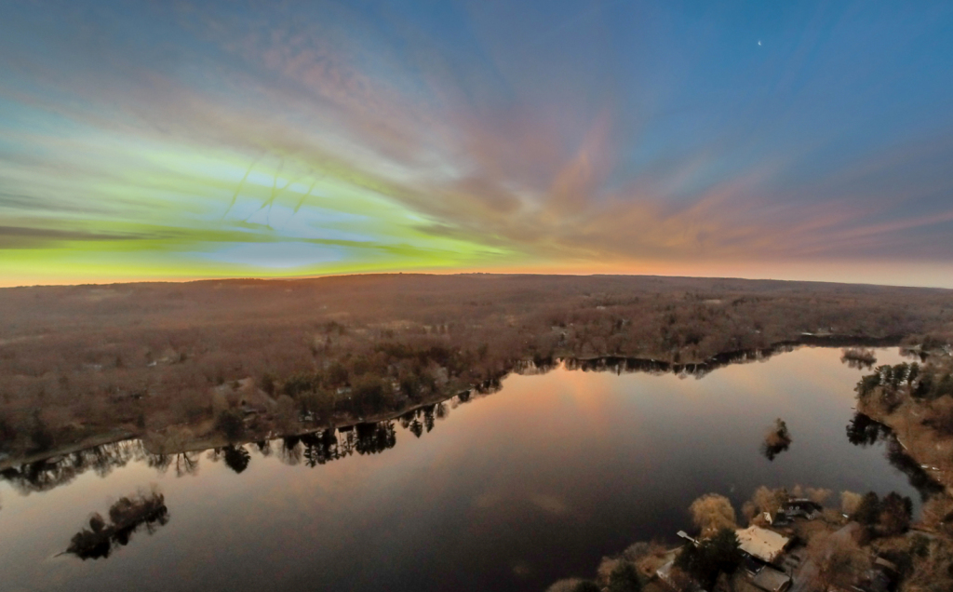
Allowing the System to Function Naturally
Baseline Data
How will the lake function?
Would late summer algae blooms occur
Photo By Stephan White

Slide 16
Curlyleaf Pondweed
Image from https://www.thinglink.com/scene/581452638105632769

Slide 17
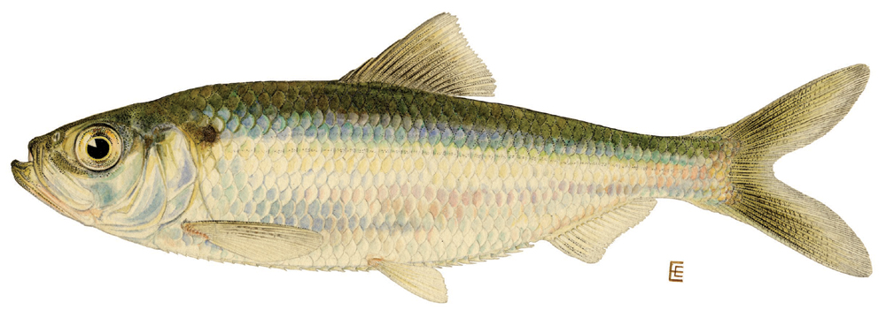
Alewife (Alosa pseudoharengus)
Anadromous- Leave ocean to spawn in freshwater
after young hatch they go back to the ocean
Spawn in shallow calm waters
Landlocked populations (smaller in size 4-5 inches) spawn in late March to late June
Primarily feed on zooplankton and can negatively impact the population (Werner, 2004)

Slide 18
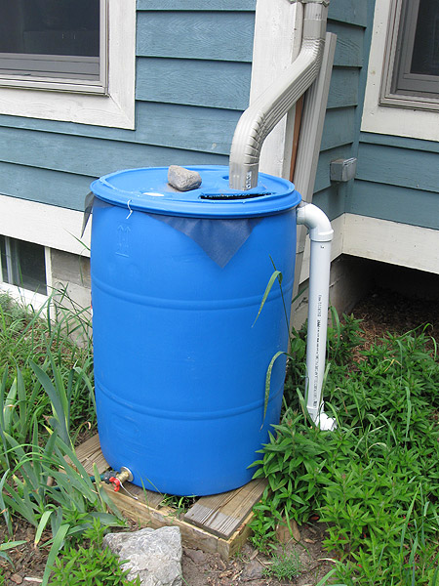
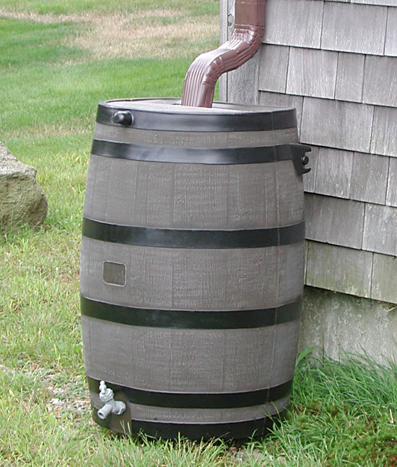
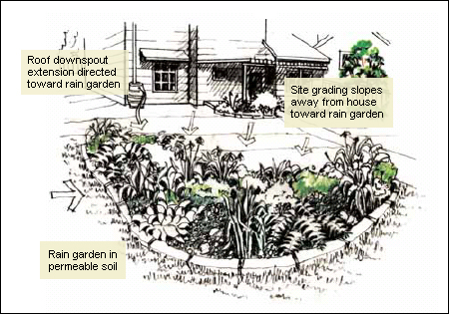
Home-Owner BMPs
In Home
Water source appliances are set on low
Use phosphorus free detergents and soaps
Outside of your Home
Rain Gardens
Rain Barrels
Leave grass cuttings on your lawn
http://www.diynetwork.com/how-to/outdoors/structures/how-to-create-a-rain-barrel

Slide 19
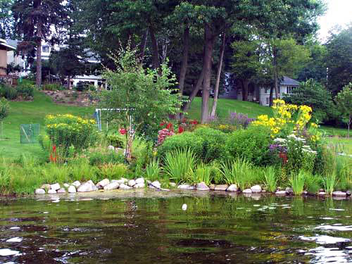
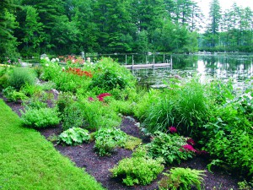
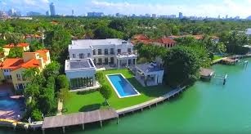
Lakescaping: the creation of buffer zones in the watershed of a lake
Ideally a buffer zone should be 20-25 feet (starting in the water)
Native plants will attract wanted wildlife
Does not need to look “Un-Kempt”
Can reduce runoff and nutrients entering the lake
www.thelakeshoreguys.com
Mainelakes.org
Skyfiveproperties.com

Slide 20
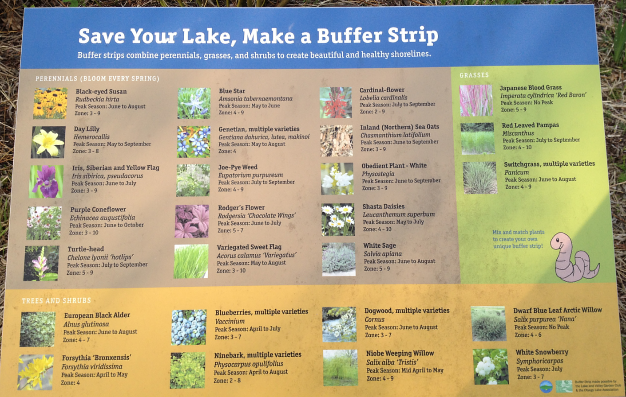
Sign of Native Plants taken from Cooperstown Boat Launch Buffer Strip Garden

Slide 21
Questions?
Photo By Eddie K Photography
Notes:
Water Quality improvement projects NYSDEC

Slide 22
Thank You
Dr. Bill Harman SUNY Oneonta BFS
Dr. Kiyoko Yakota SUNY Oneonta BFS
Dr. Dan Stich SUNY Oneonta BFS
Matt Albright SUNY Oneonta BFS
Holly Waterfield SUNY Oneonta BFS
Lara Gorton TLPOA
Solitude Lake Management
Fellow Classmates

Slide 23
References
NYSDEC. 2013. “CSLAP 2013 Lake Water Quality Summary: Lake Truesdale.” New York State Department of Environmental Conservation via Lara Gorton. http://www.dec.ny.gov.
Ryder, Thomas, and Robert Jontos. 2001. “Lake Evaluation and Enhancement Plan Lake Truesdale Lewisboro, New York.”
Truesdale Lake 2006-2007 Herbicide and Algaecide Treatments Conducted by Allied Biological Inc. via Glenn Sullivan Solitude Lake Management
Werner, Robert. 2004. “Freshwater Fishes of the Northeastern United States” Syracuse University Press.

